Slide 1
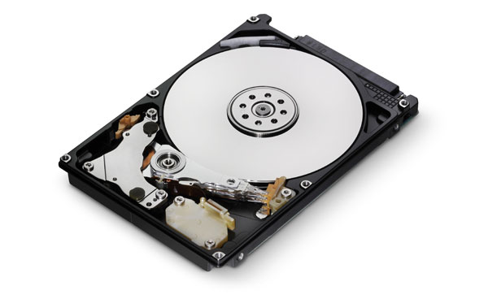
Storage Device
Student name: Shamma saeed
Student id: H00300141
teacher: Christine jhons

Slide 2
Hard drive
- It’s a device used to permanently store and retrieve information.

Slide 3
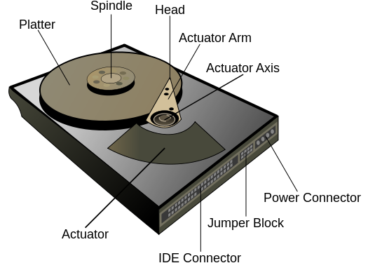
Contains of:

Slide 4
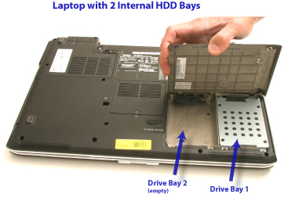
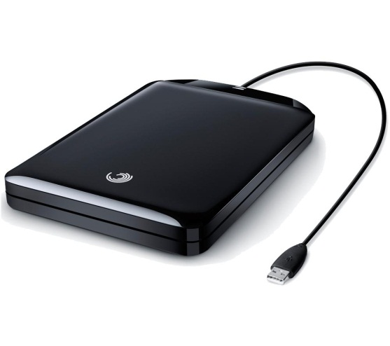
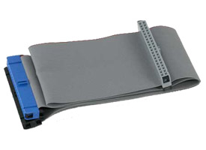
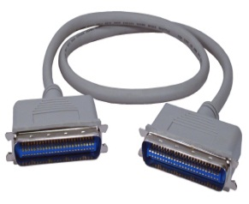
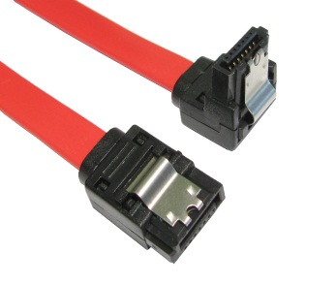
internal External
Types of hard drive:
1- reside in a drive bay.
2- connect to the motherboard using an ATA, SCIS, or SATS cable.
3- powered by a connection to the PSU (power supply unit).
Backup data
Expand the available
disc space
- More space.
stored in an enclosure
Example:

Slide 5
internal External
Shapes and sizes:
Large as a book
- Small as a cell phone
2.5 or 3.5 for desktops of laptops or computers

Slide 6
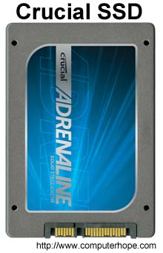
Solid state drives
SSD is becoming more and more popular because of:
1- more capacity
2- Value per dollar

Slide 7
How is data read and stored on a hard drive:
1- Examines the hard drive's File to determine file location and available write areas.
2- The disk controller instructs the actuator to move the read/write arm and align the read/write head.

Slide 8
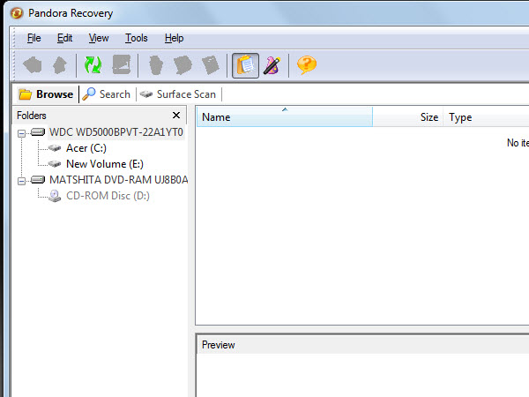
How to recover dtat from hard drive:
1- Launch the software, and choose a module according to the reason for data loss (deletion/format/partotion loss).

Slide 9
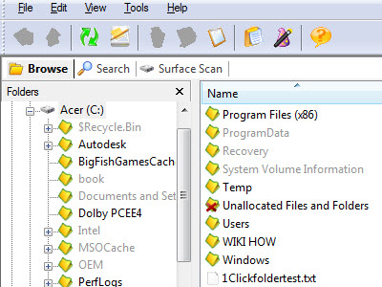
2- Choose the volume where there were lost data and click "NEXT" to start searching, then you will see a list of volumes where data loss possibly

Slide 10
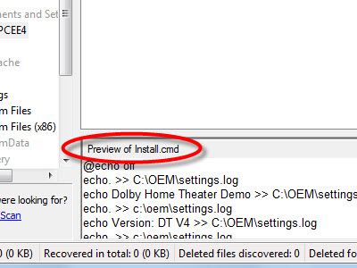
3- Choose and preview the lost data that you want to recover and press the "Next" button.

Slide 11
How to format haRd drive:
1- Back up your data
2- Use the Windows XP CD-ROM to boot the computer.
3- Select the "Recovery Console" option.
4- At the prompt, type FORMAT C:
5- Also open computer, then right click "local disk (c:)

Slide 12
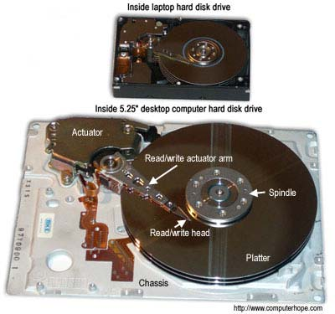
Laptop
computer

Slide 13
References
Hard disk drive. (n.d.). Retrieved November 11, 2015, from Wikipedia website: http://www.computerhope.com/jargon/h/harddriv.htm
Hard drive. (n.d.). Retrieved November 11, 2015, from computer hope website: http://www.computerhope.com/jargon/h/harddriv.htm
http://www.wikihow.com/Format-a-Hard-Drive
http://www.wikihow.com/Recover-Lost-Data

